Slide 1



Discover the CAR RENTAL SERVICE FROM Car. COM
CAR.COM
Welcome to our car rental service, where the open road awaits. Rent the perfect vehicle for your next adventure and experience the convenience and flexibility of on-demand transportation.
By Harsh Yadav
Arpit Parmar
Raj Patel

Slide 2

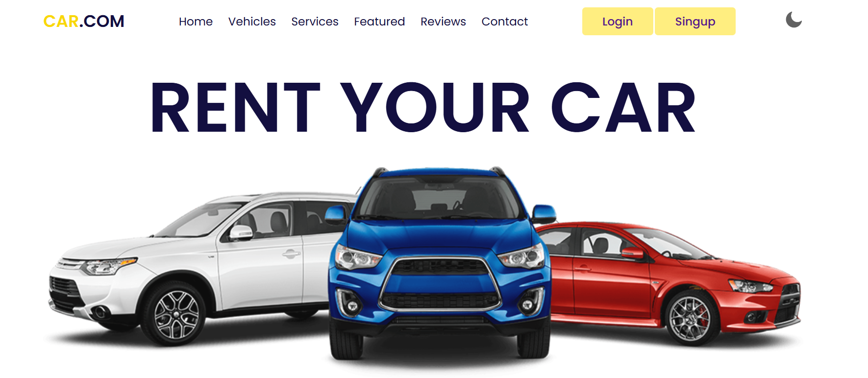
Easy Login and Sign-up
Seamless Sign-up
Quickly create an account and start renting in minutes. No complicated forms, just a simple and secure process.
Saved Preferences
Your account remembers your personal details and rental history, making future bookings a breeze.
Flexible Access
Log in from any device to manage your rentals, view invoices, and make changes on the go.

Slide 3
Wide Selection of Vehicles
Economy Cars
SUVs and Vans
Premium Sedans
Efficient and affordable options for everyday driving or city exploration.
Spacious and versatile vehicles perfect for families, groups, or outdoor adventures.
Indulge in the comfort and style of our high-end car models for a luxurious experience.

Slide 4
Affordable Rates and Flexible Packages
1
Competitive Pricing
2
Flexible Packages
3
Special Offers
Our rates are designed to fit any budget, without compromising on quality.
Choose from a variety of rental durations and mileage options to suit your needs.
Take advantage of our seasonal discounts, loyalty programs, and promotional deals.

Slide 5





Convenient Pickup and Drop-off
Multiple Locations
Rent and return your vehicle at any of our conveniently located branches.
Curbside Service
Enjoy a seamless experience with our quick and efficient pickup and drop-off process.
Airport Rentals
Start your trip right with our on-site car rental service at major airports.

Slide 6





Exceptional Customer Service
24/7 Support
Reach our friendly and knowledgeable team anytime, anywhere.
Roadside Assistance
Enjoy peace of mind with our comprehensive breakdown coverage.
Satisfaction Guarantee
We're committed to ensuring your rental experience exceeds your expectations.

Slide 7





Links to Popular Websites
Google
https://www.slideshare.net/slideshow/car-rental-project-ppt/247308743
YouTube
https://www.youtube.com/@CarpoolVenom
Car Wala
https://www.carwale.com/

Slide 8


Thank You
Thank you for taking the time to meet with us today.

